Slide 1
New Terminal Program Lafayette Regional Airport
Program Update
November 8, 2017

Slide 2
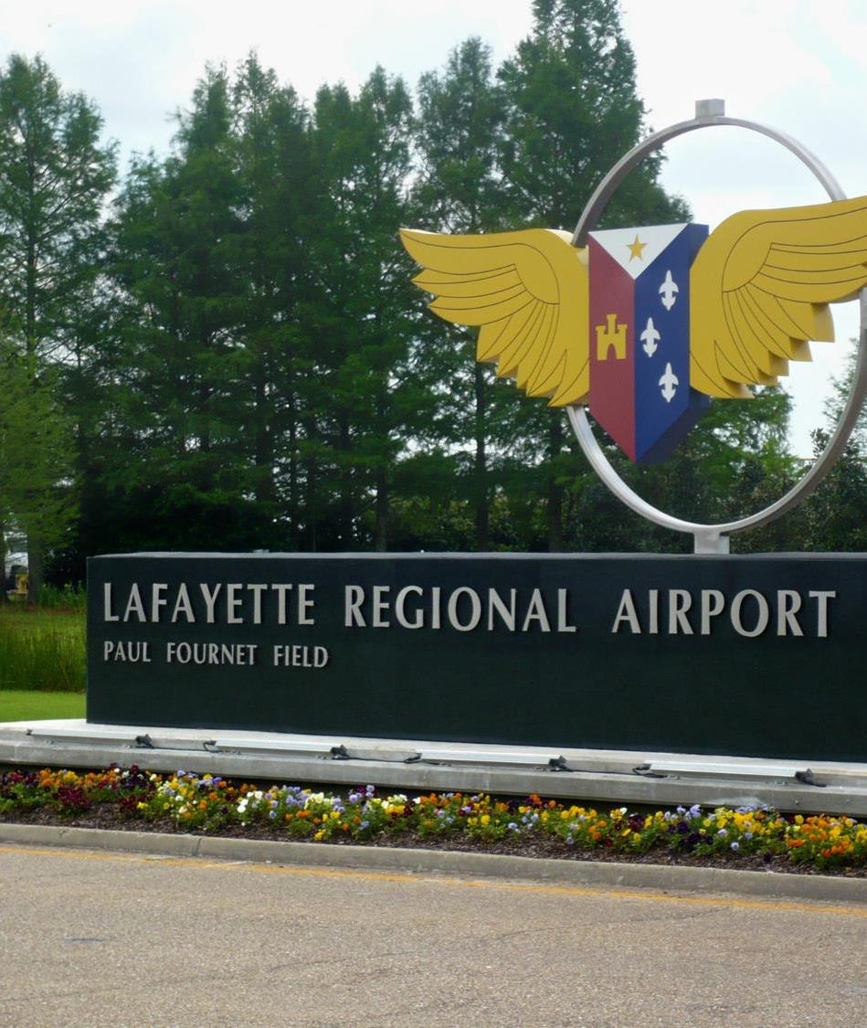
Agenda
Airside & Landside Site Analysis
Terminal Facilities
Cost / Budget Update
Schedule

Slide 3
Terminal program: site

Slide 4
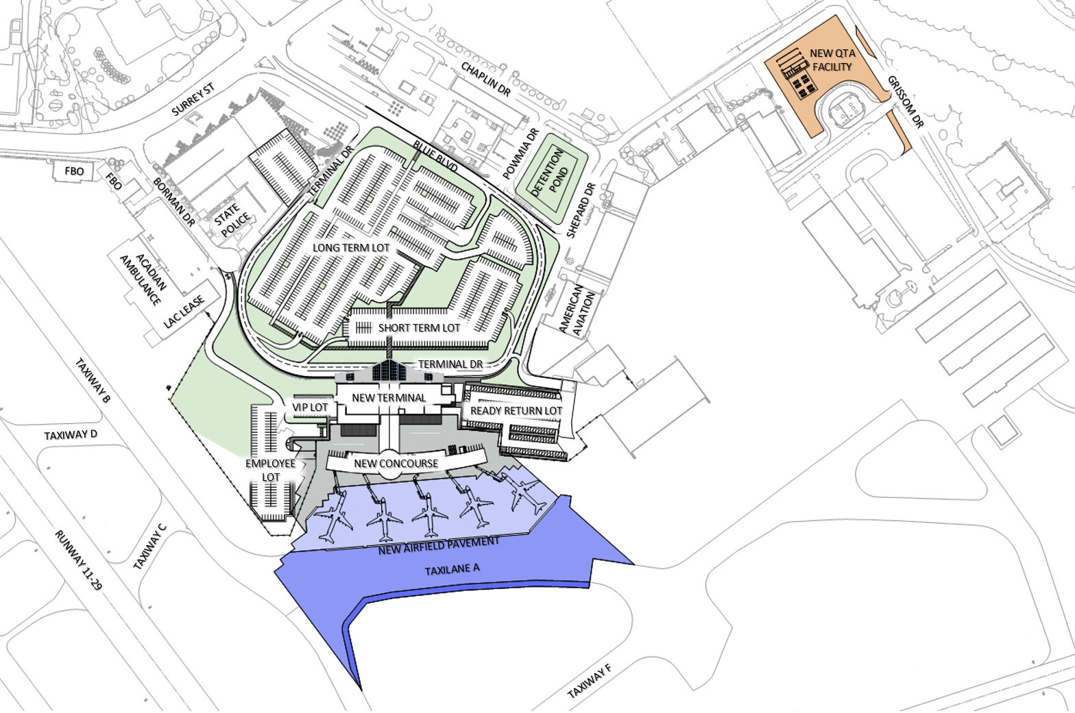
OVERALL SITE PLAN

Slide 5
Quick Turn Around

Slide 6
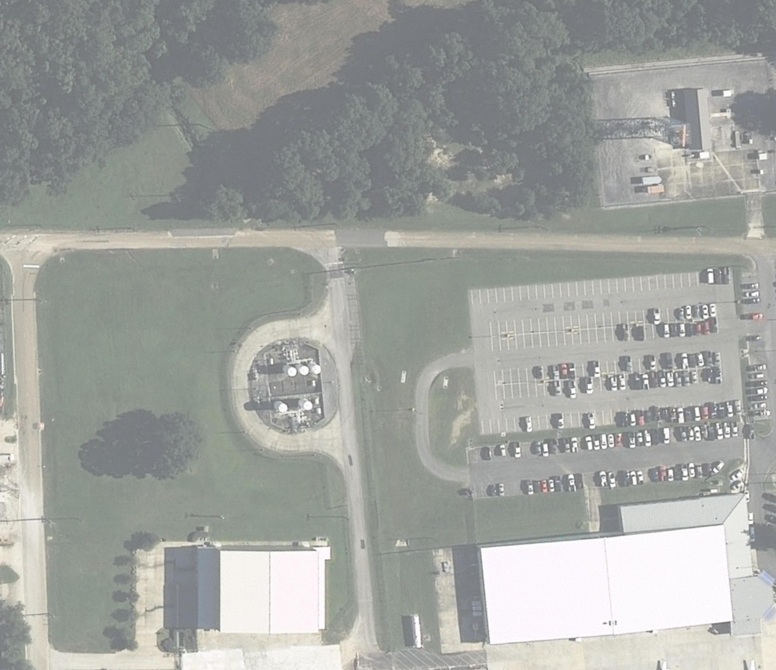
Notes:
Preferred location

Slide 7
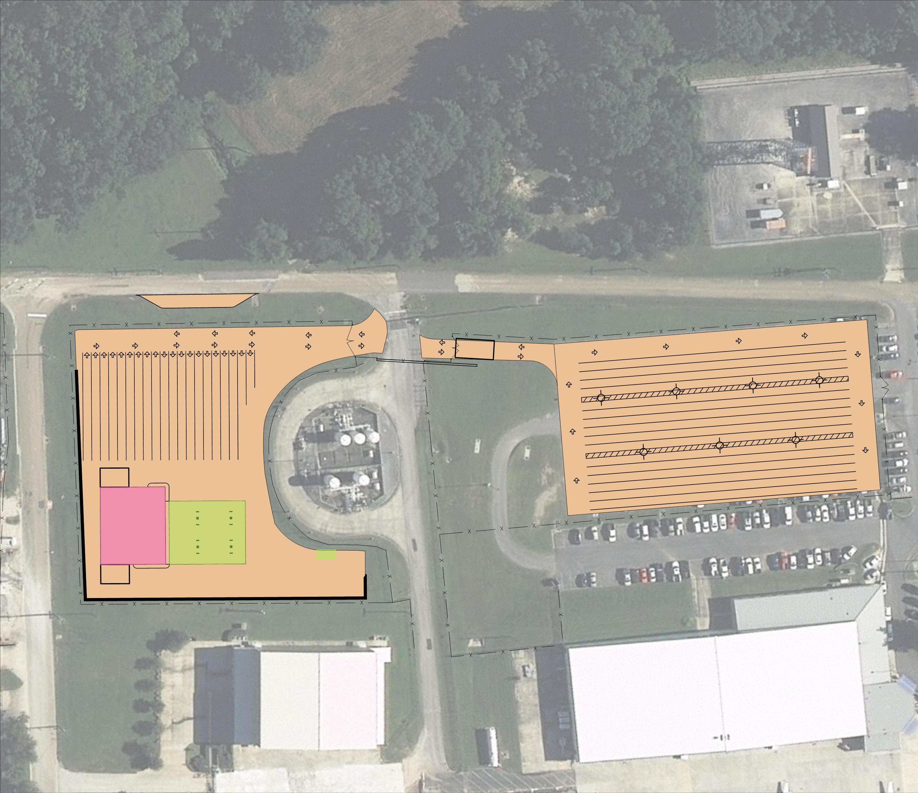

Slide 8
QTA Site Plan

Slide 9
QTA Floor Plan

Slide 10
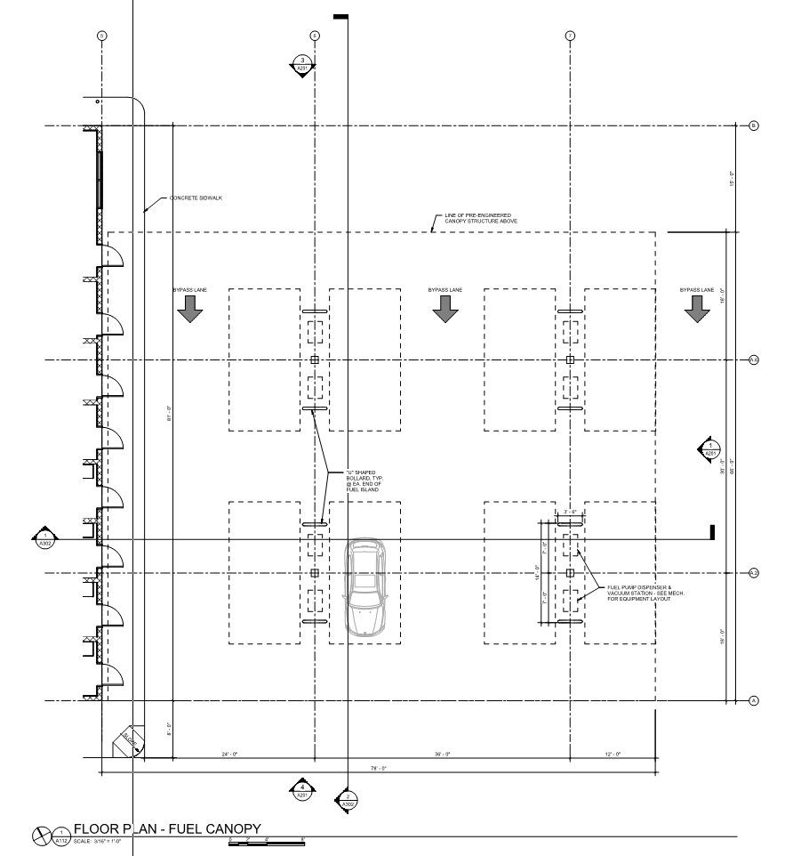
QTA Floor Plan

Slide 11
Perspective Looking North

Slide 12
Perspective Looking South

Slide 13
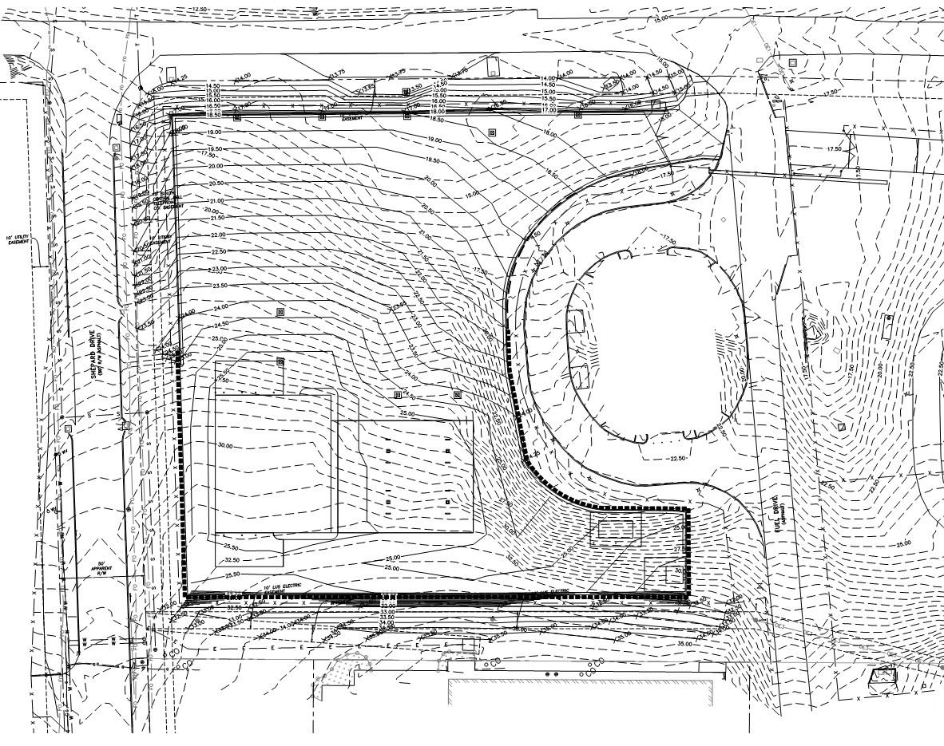
QTA Floor Plan

Slide 14
Perspective Southeast

Slide 15
Terminal program: RTR Cable

Slide 16
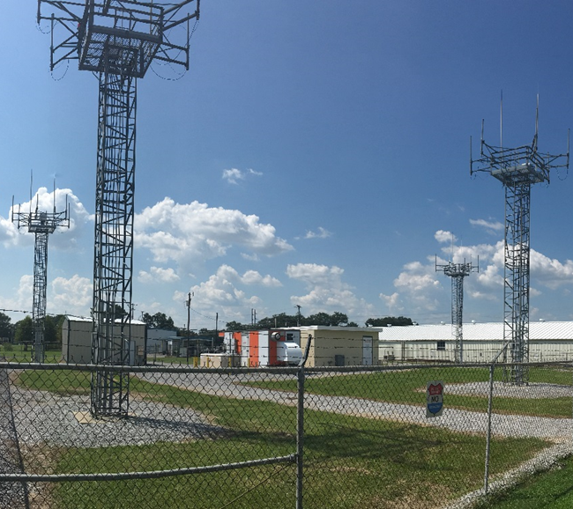
RTR Update
Signal Analysis
FAA Coordination
Next Steps

Slide 17
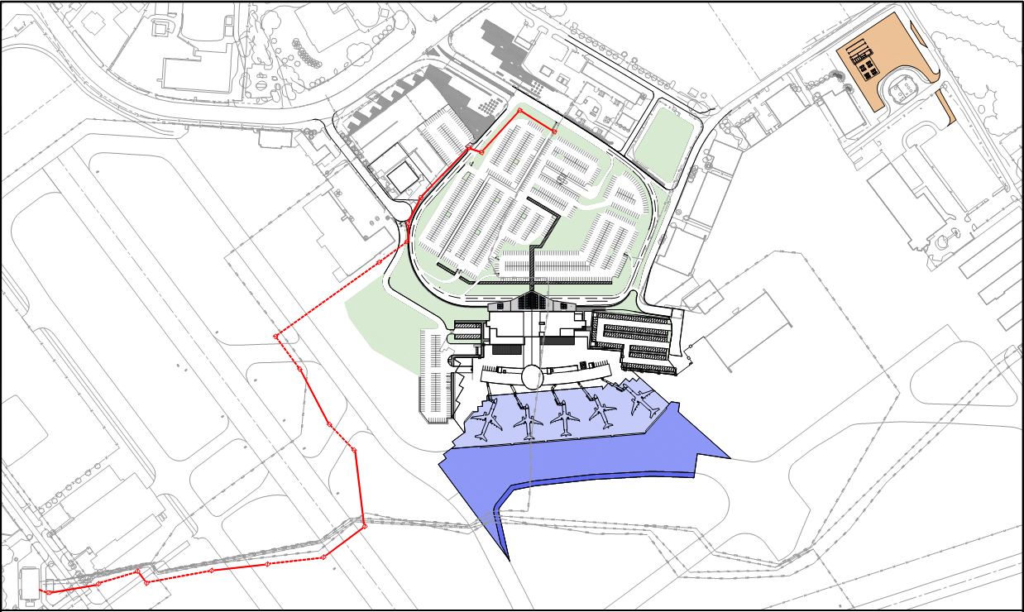
RTR CABLE RELOCATION
QTA FACILITY
CHAPLIN DR
SURREY ST
SHEPARD DR
BLUE BLVD
DETENTION
POND
EXISTING RTR CABLE
BORMAN DR
LONG TERM LOT
TAXIWAY B
PROPOSED RTR CABLE
SHORT TERM LOT
TERMINAL DR
VIP LOT
NEW TERMINAL
READY RETURN LOT
RUNWAY 11-29
EMPLOYEE
LOT
TAXIWAY A
NEW AIRFIELD PAVEMENT
EXISTING RTR CABLE

Slide 18
Terminal program: building

Slide 19
FIRST FLOOR LAYOUT

Slide 20
SECOND FLOOR LAYOUT

Slide 21
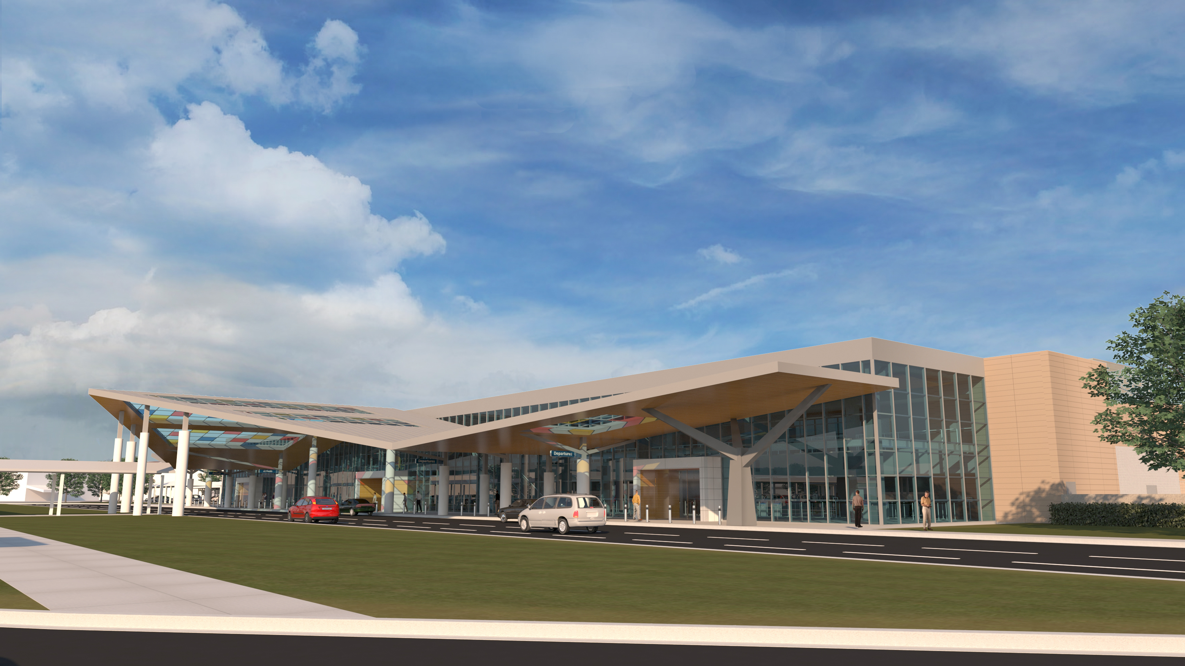
EXTERIOR PERSPECTIVE - CURBSIDE

Slide 22
EXTERIOR PERSPECTIVE - LANDSIDE

Slide 23
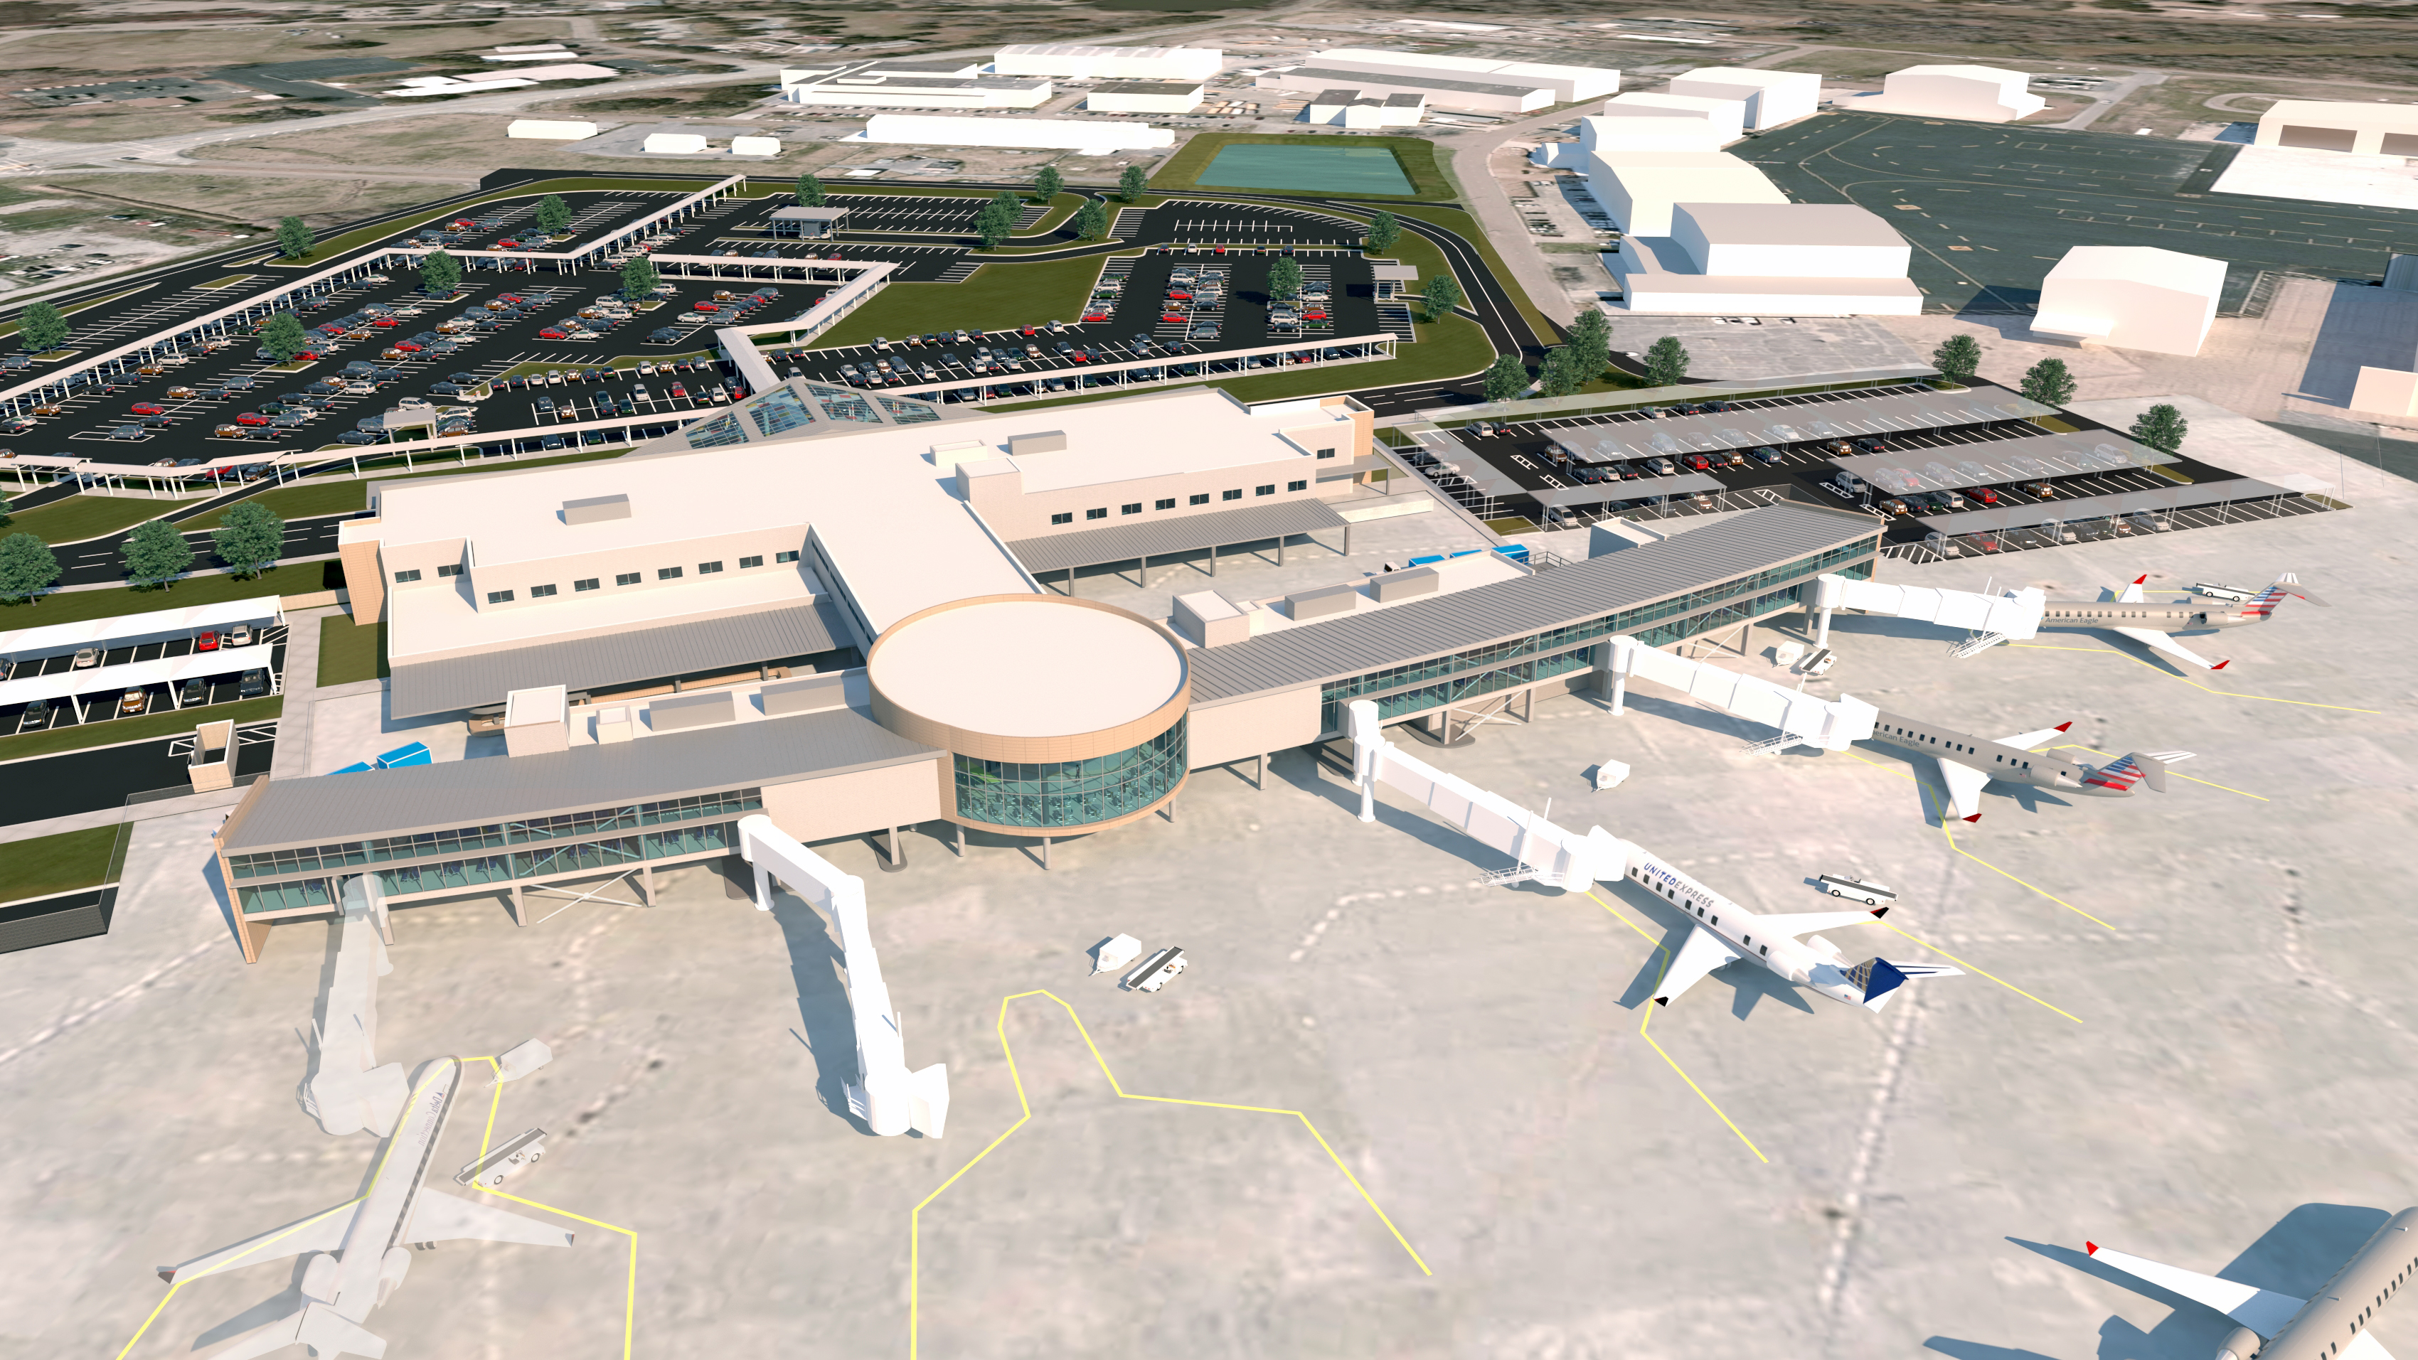
EXTERIOR PERSPECTIVE - AIRSIDE

Slide 24
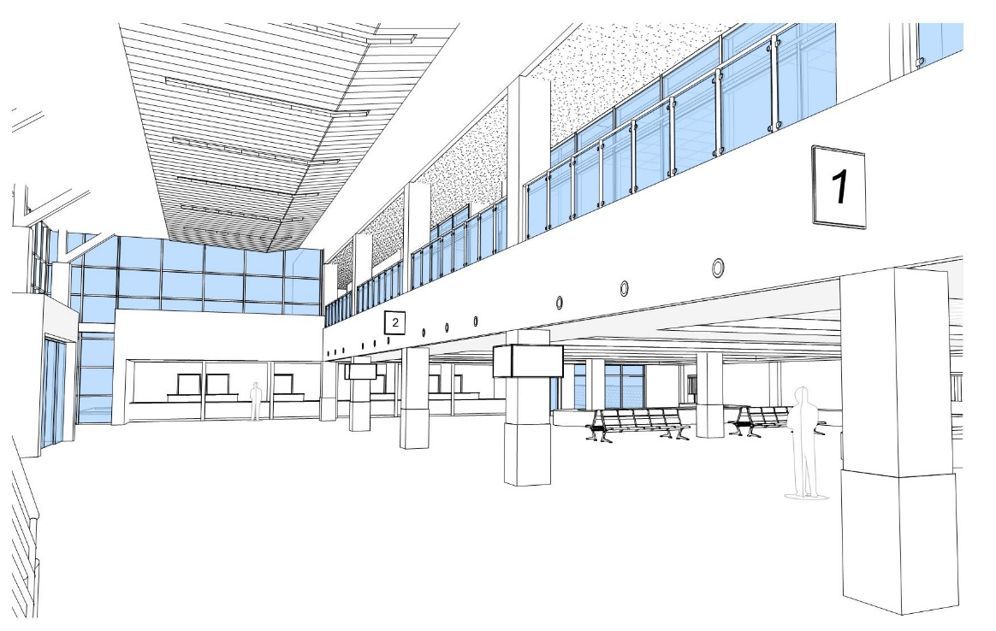
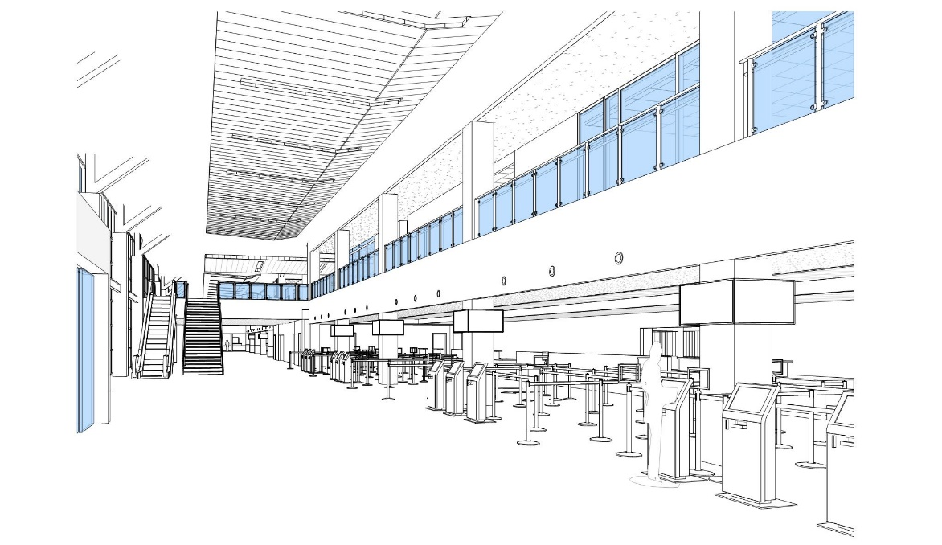
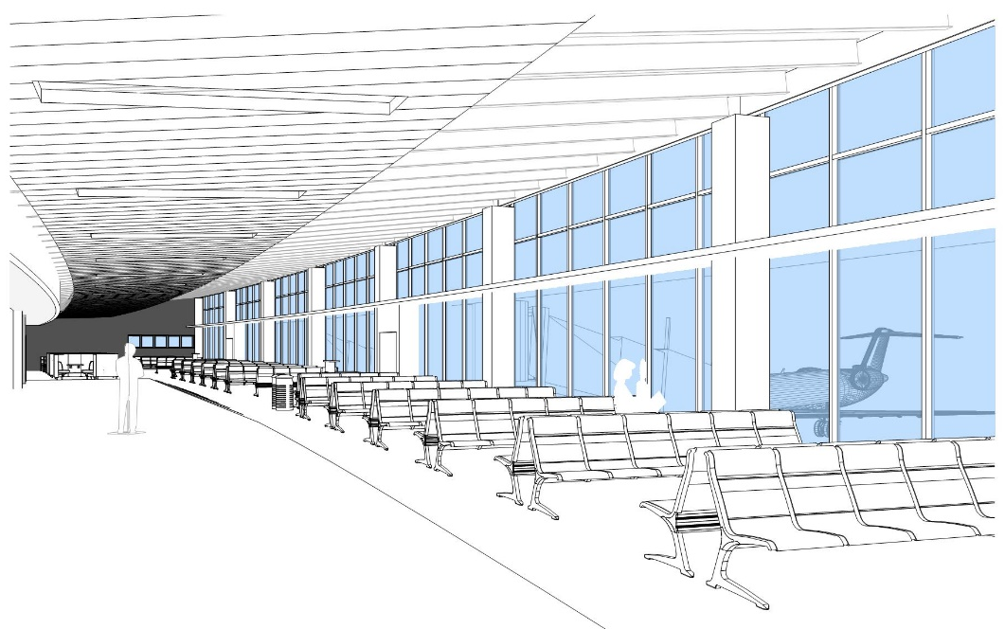
INTERIOR PERSPECTIVE – LOBBY/TICKETING

Slide 25
Terminal program: budget and schedule

Slide 26
Schematic Design - Terminal Estimate
 | Terminal Building*
Construction | $61.8M
Program | $79.0M
*Terminal Building cost does not include Landside or Airside Civil Site or Costs associated with the Quick Turn Around Facility
Notes:
Update with new information

Slide 27
Schedule*
*Schedule is based on receiving FAA discretionary funding starting in year 2018 and no impacts related to the RTR Facility

Slide 28
QUESTIONS?

